Slide 1
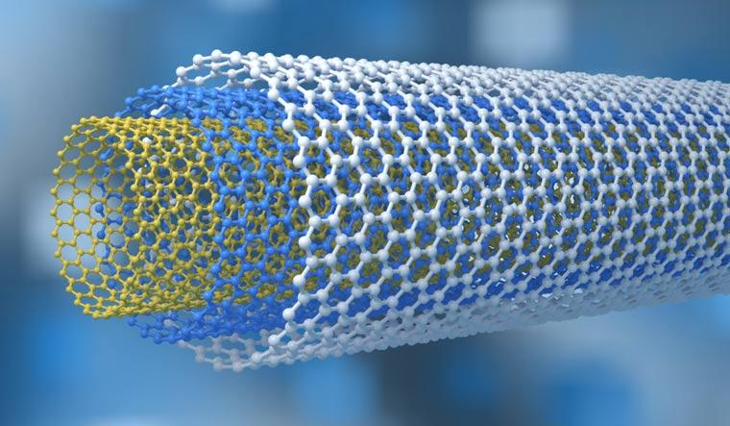
Covalent network

Slide 2
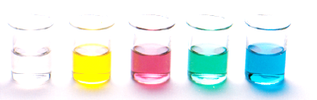
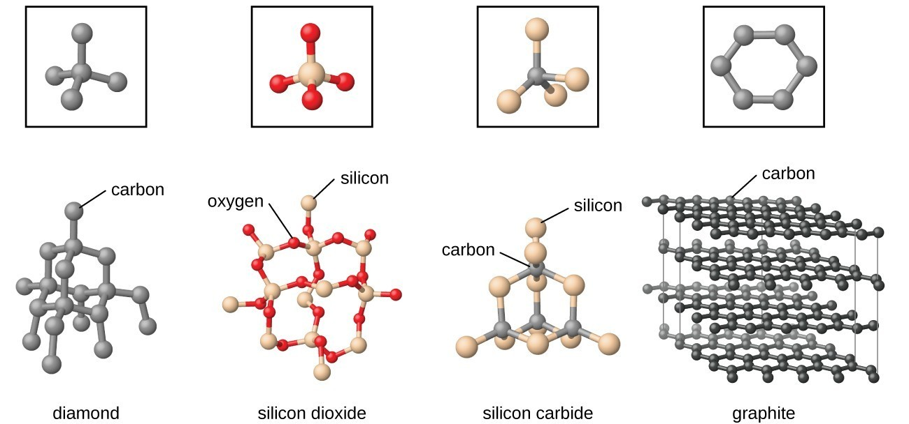
Covalent network
Common substances that form covalent network structures include boron (B), carbon (C), silicon (Si), silicon dioxide (SiO₂) and silicon carbide (SiC)
Covalent network structures form a continuous array of covalently bonded atoms

Slide 3
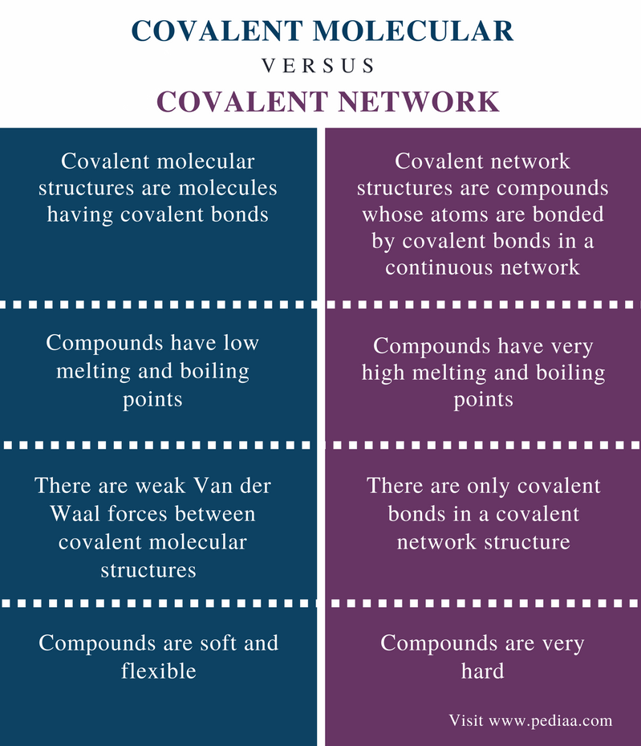
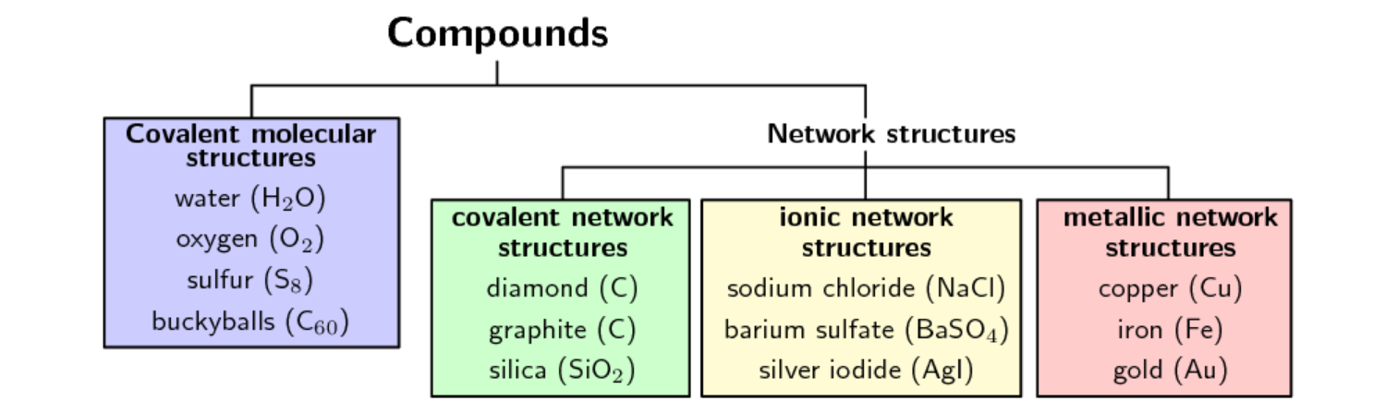
Covalent network

Slide 4
Carbon allotropes
Number of different allotropes of carbon
Use our knowledge of covalent bonding and intramolecular/intermolecular forces to example the structure and properties of the following allotropes:
Diamond
Graphite and graphene
Fullerenes – spheres and tubes

Slide 5
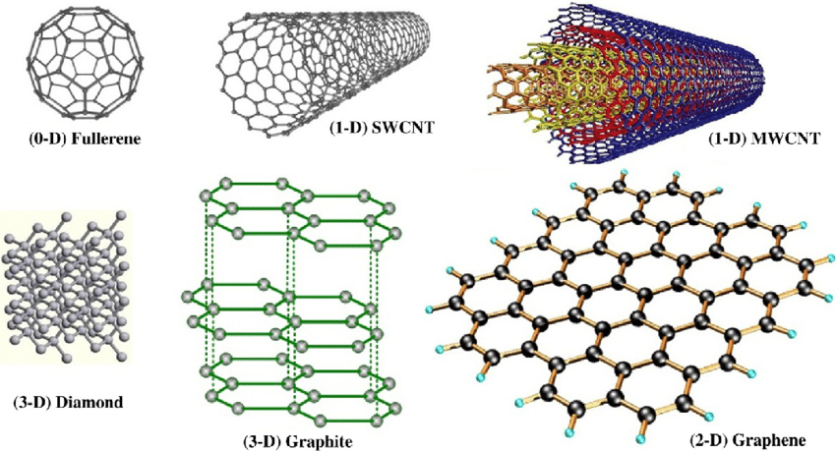
Carbon allotropes

Slide 6
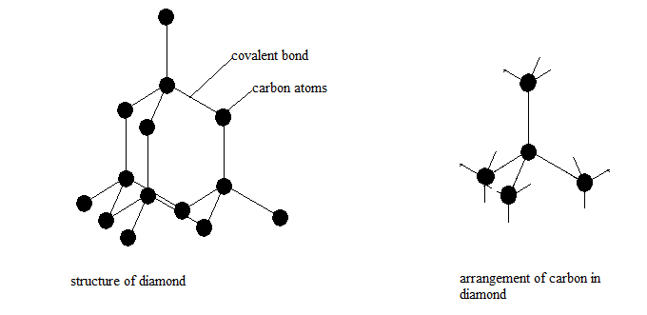
Diamond
Diamond is pure carbon (only contains carbon atoms)
Each carbon is covalently bonded to four other carbons
3D arrangement of atoms called a tetrahedral
The 3D array produces a material that is:
Hard and brittle
Non-conducting
High melting and boiling point

Slide 7
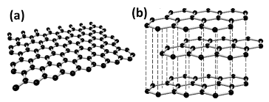
Graphite and graphene
Graphite is pure carbon (only contains carbon atoms)
Each carbon is covalently bonded to three other carbon
Carbon atoms arrange as a sheet of hexagonal rings, forming 2D sheets of atoms called Graphene (picture a)
When the sheets of graphene stack together they form Graphite (picture b)

Slide 8
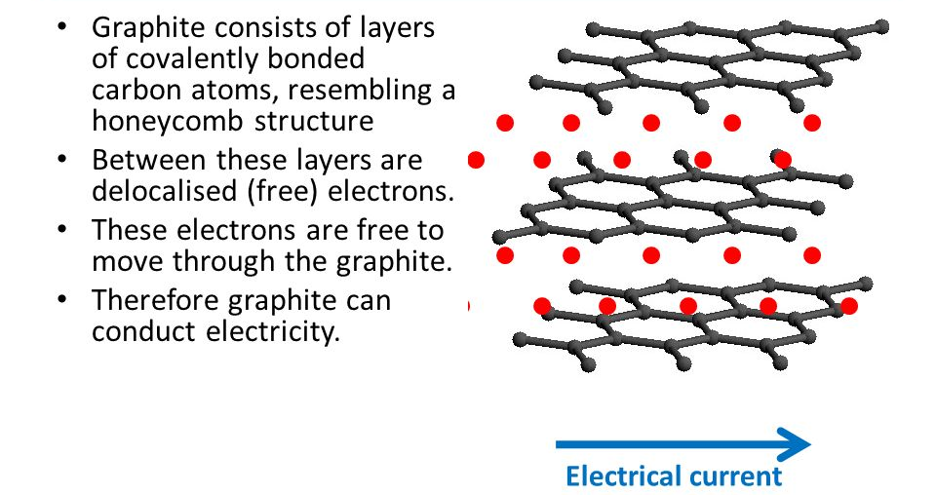
Graphite and graphene

Slide 9
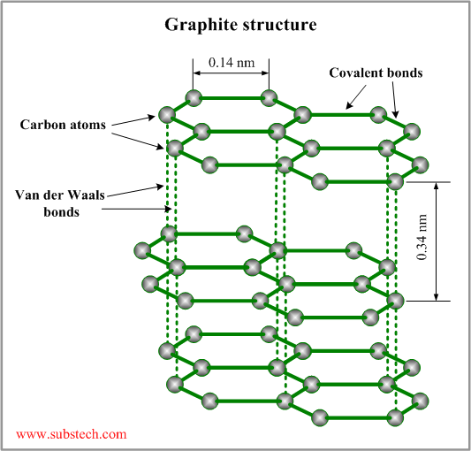

Graphite and graphene
Soft – weak van der Waals forces (intermolecular) between the sheets
High melting and boiling points – strong covalent bonds within the sheet.

Slide 10
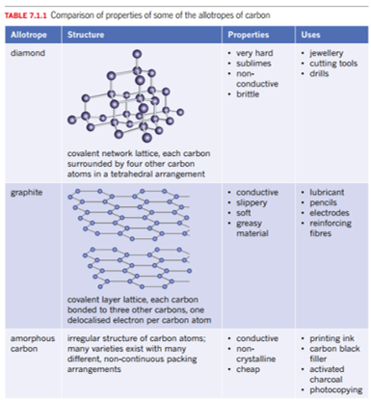
Summary so far

Slide 11
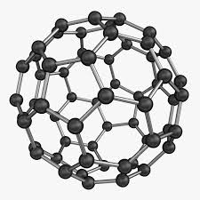
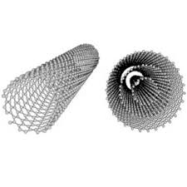
Fullerenes
Fullerenes are a recently discovered allotrope of carbon
Two basic types of fullerenes:
Cage structures - for example Buckminsterfullerene, C₆₀ (also referred to as a ‘buckyball’) as well as larger C₇₀, C₈₀ and bigger cages
Tube structures – for example carbon nanotubes (CNTs) and multi-walled nanotubes (MWNTs)

Slide 12
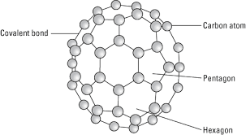
Fullerenes – cages
The first fullerene discovered was the buckminsterfullerene, C₆₀, commonly called the ‘buckyball’
It was discovered in 1985
Buckyballs contain 60 covalently bonded carbon atoms, arranged in a cage structure
The buckyball cage structure has 12 pentagons and 20 hexagons, it resembles a soccer ball

Slide 13
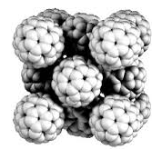
Fullerenes – cages
Since 1985, other fullerenes with cage structures have been identified, including C₇₀ and C₈₀
Buckyballs (C₆₀) can be found naturally occurring in soot
Buckyballs are a soft powdery material (typically black or brownish in colour) as between each molecule (one molecule = one cage) are only weak van der Waals interactions
In the pure form buckyballs are semiconductors

Slide 14
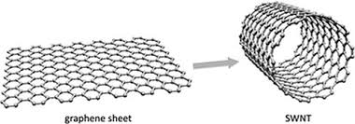
Fullerenes – tubes
Another type of fullerene are tube structures such as carbon nanotubes (CNTs) and multi-walled nanotubes (MWNTs)
CNTs can be visualized as a sheet of graphene rolled in to a cylinder

Slide 15
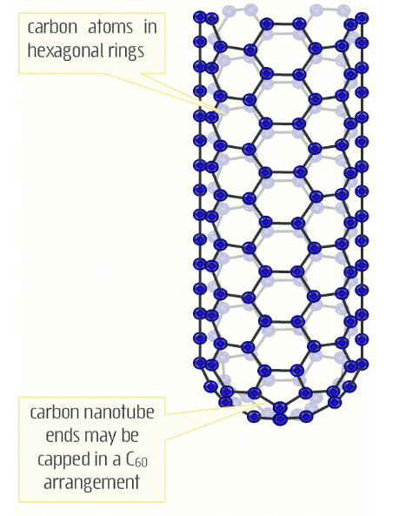
Fullerenes – tubes
Along the length of the tube carbon atoms are covalently bonded into interlocking hexagonal arrangement
The two ends can be open or capped in a C₆₀ arrangement
CNTs have a diameter of around 1 nm (1 x 10⁻⁹ m) and lengths of up to micrometers (1 x 10⁻⁶ m). Although in theory their length could be limitless and depends on how they were made.

Slide 16
Fullerenes – tubes
Properties of CNTs
Individual CNT have great strength and flexibility – due to each atom being covalently bonded to its neighbouring atoms
CNTs when compared to steel of the same dimensions are much stronger and lighter. CNTs have a tensile strength 100 times that of steel and a density about a quarter.
The potential to create super strong lightweight structures using CNTs receive a lot of attention from engineers and researchers around the world

Slide 17
Fullerenes – tubes
Properties of CNTs
CNTs have unusual electrical properties
Depending on their diameter and symmetry they can be semiconductors or excellent conductors
Individual CNTs can carry current densities 1000 times greater than metals like copper and silver
CNTs can conduct current down the tube length producing almost no heat
Potential applications include globe filaments and efficient power transmission to electronic semiconductor devices (e.g. transitors, diode, and computing applications)

Slide 18
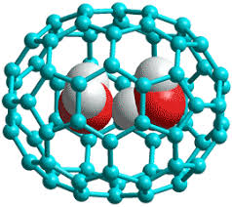
Fullerenes – applications
Fullerenes and their potential applications have generated a lot of interest due to their unique mechanical, optical and electrical properties.
Fullerenes can act as molecular containers, bind to surfaces and have things bind to their surface. Together with their extremely large surface area, giving researchers huge flexibility in terms of applications
The study and potential applications of fullerenes makes up a large part of Nanotechnology

